Slide 1
CS 3600 Introduction to Artificial Intelligence
James M. Rehg
School of Interactive Computing
College of Computing
Georgia Tech

Slide 2
First Day
Logistics
Introduction to Teaching Team
Goals for this Class
Background on Artificial Intelligence

Slide 3
T-Square
Will be set-up by tomorrow
Everything will be announced there
All assignments will be obtained and turned-in there
Lecture slides will be posted in the resources folder weekly

Slide 4

Introductions
Instructor: Jim Rehg
Full Professor in School of IC
Ph.D. from CMU (in 1995)
DEC CRL (1995) → Georgia Tech (2001)
Married with 4 kids (ages 9, 11, 16, 19)
http://rehg.org
rehg@gatech.edu
Office hours will be announced soon

Slide 5
Introductions
Grad TAs:
Shagun Jhaver
Yun Liu
Undergrad TAs:
Oleg Filatov (Head TA)
Manav Dutta
Arjun Garg
Caroline Paulus
Office hours to be announced this week

Slide 6
Overload Requests
Do the process online (follow CoC policy)
Please decide ASAP if you are just holding the class
so others can get in!

Slide 7
What is AI?
AI = Rational Agents
How to think and act rationally?
S = state of the world (perceived by agent)
A = set of possible agent actions
S x A … is reeeeeaaaallllly big!
Approximations and efficient algorithms are critical
The world is inherently uncertain and ambiguous
Probabilistic models and methods are critical

Slide 8
Topics We’ll Cover
Defining Agents and Environments
Formulating AI as search
Games and AI
Logic and Logical Inference
Probability and Probabilistic Reasoning
Dynamic Bayes Networks and HMMs
Decision making: Planning and MDPs
Supervised Learning: Neural Nets, SVMs, Decision Trees

Slide 9
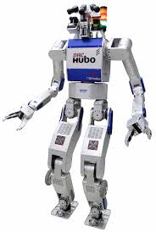
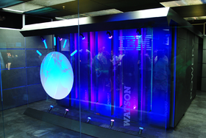
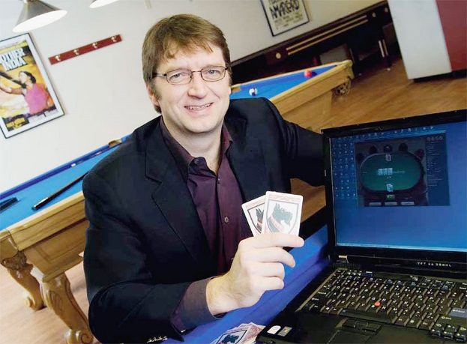
“Hot” Topics in AI
Natural Language
Processing
Large-scale Probabilistic Search
Perception, Planning,
Actuation
Notes:
Left to right: The IBM Watson computer system for playing Jeopardy, Tuomas Sandholm at CMU with the Claudico system for playing No Limit Texas Hold’Em, and KAIST DRC-HUBO humanoid robot which won the 2015 DARPA Robot Challenge

Slide 10

Brains vs AI
Claudico: Best No-Limit Texas Hold’em Agent in World (CMU)
Humans: Jason Les, Doug Polk, Bjorn Li and Dong Kim (top 10)
Competition: April 2015 at Rivers Casino, Pittsburgh PA
Outcome: Humans won! ($732,713 of virtual money, Bjorn Li tops)
Tuomas Sandholm (CMU)
“statistically speaking the game was tie”
Doug Polk
“Betting $19,000 to win a $700 pot just isn't something that a person would do”

Slide 11

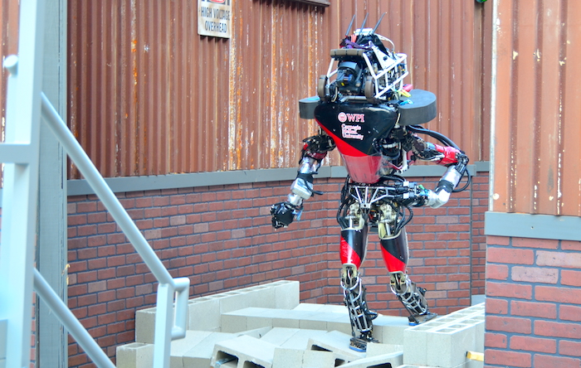
DARPA Robotics Challenge

Slide 12
Questions?

